Slide 1

Flight Gear Android App
Matan Saloniko
Idan Givati
Advanced Programming 2 - 89211
Bar-Ilan University

Slide 2
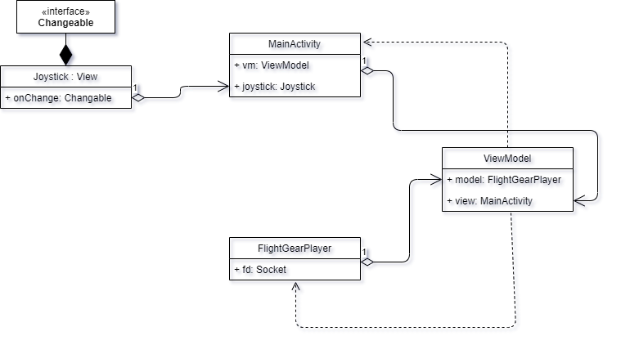
As we can see, the app uses the MVVM architecture.
The MainActivity (View) sends the data and changes
made in the view to the ViewModel which then
passes different commands to the FlightGearPlayer (model)
The Joystick is a class that acts as a view and can be used in different projects as it is implemented through a function interface which makes it a standalone view that can be added independently.

Slide 3



As you can see, the Joystick class has a member of type Changeable which is a functional interface we’ve created.
That way, we can set a lambda expression in order to control the joystick and have it do what we want without tying the Joystick class to this specific project.
Basically we’ve created a separate class that can be used in many different projects that require a joystick without making any changes to the current class we’ve created.
Main Activity

Slide 4
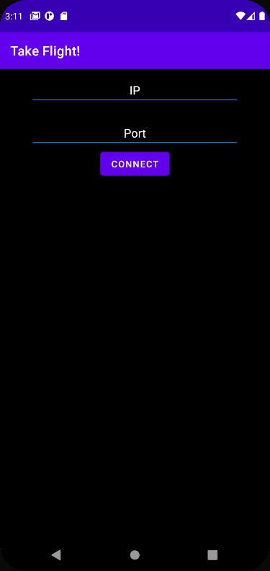
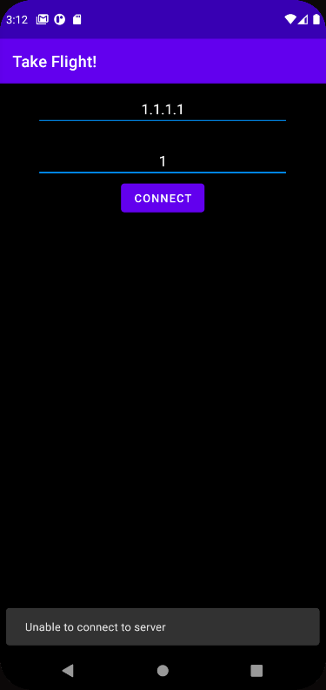
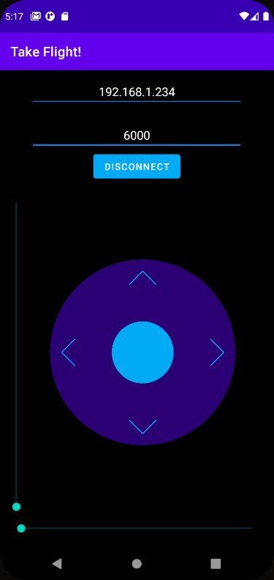
Main screen
Wrong server IP or port
Connected to server

Slide 5
Project Description
This app is fairly simple.
In this project, our goal was to create an app that lets you connect to FlightGear and control a flight simulation.
When you open the app you're greeted with a clean and simple screen that lets you enter the IP and port of the FlightGear server you've created. (If you are not familiar with FlightGear and how to create a server, do not worry, we will cover that later).

Slide 6
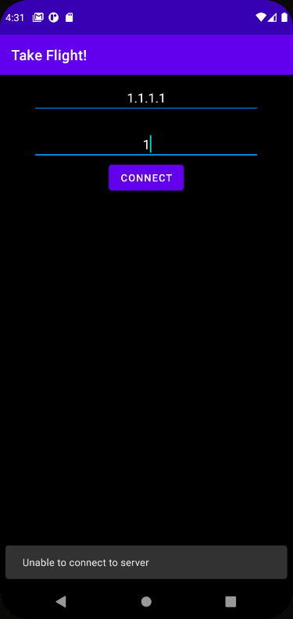
In the case that you've entered the wrong IP or port and the app failed to connect, you will be presented with an error message.
After entering the correct IP and port, the app can finally connect to the server and you will be presented with the controllers.

Slide 7

A short description about the controls
To the left, you'll see the throttle controller that lets you adjust the throttle of the airplane.
Right at the bottom you'll see the rudder controller
At the center of the screen you'll see the joystick that lets you adjust the aileron and elevator.

Slide 8
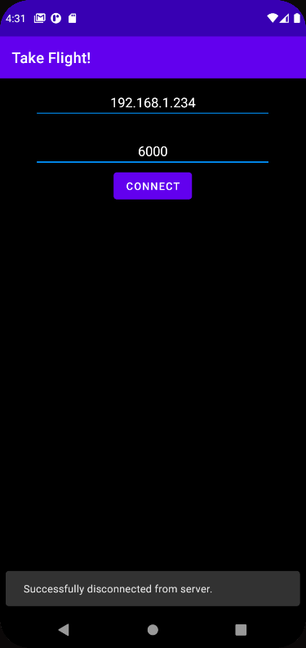
You can click the "DISCONNECT" button to disconnect from the current sever and connect to a new one if you wish to do so.

Slide 9
If you wish to see more of this project in action, you can view the short demonstration video we've created!
Or, better yet, just follow the instructions below to install the app and control the flight on your own!

Slide 10
Requirements
FlightGear is necessary in order to run the the application correctly.Download links: https://www.flightgear.org/download/
The app (.apk) or the project is also required. You can clone the repo or download the apk file here: https://bit.ly/3gKHl9Y
If you chose to clone the repo, you'll have to install Android Studio in order to run it properly. You can do that here: https://developer.android.com/studio

Slide 11
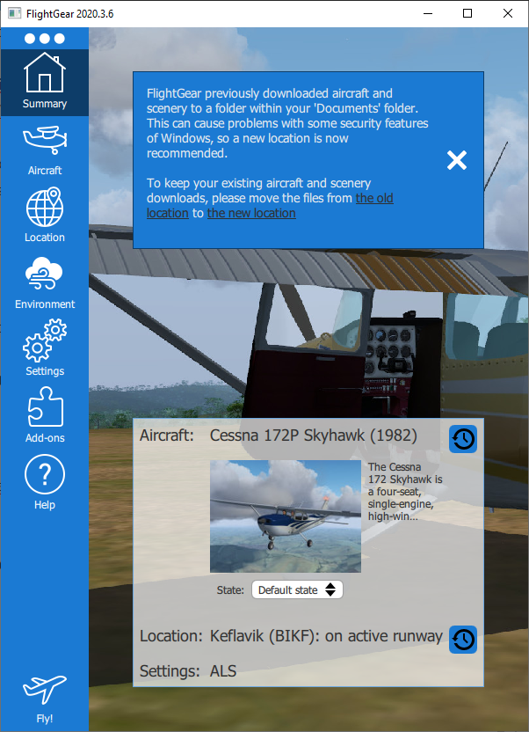
Running the project
Method 1 - The user friendly(er) way:
First of all, you'll have to install FlightGear using the link provided above.
After running FlightGear, you will be presented with this screen:

Slide 12
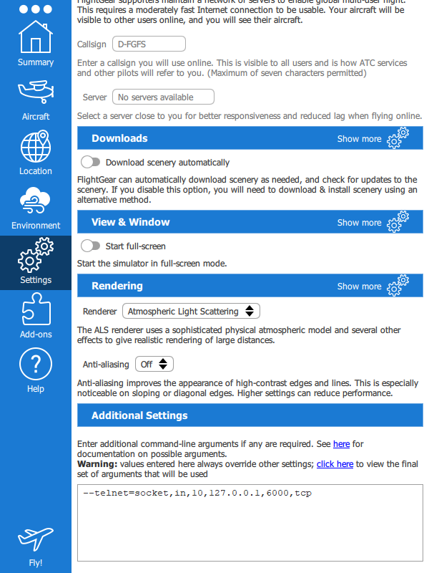
Go into the Settings panel, scroll down and enter the line below as shown in the screenshot
--telnet=socket,in,10,127.0.0.1,6000,tcp
Click “Fly!”

Slide 13
Open cmd or terminal on your machine and type the following command:
For windows: ipconfig
For Linux/MacOS: ifconfig
Check the IP shown next to "IPv4 address" and save it. We'll use that in a bit.

Slide 14
Download the .apk file from the link given: .apk file
Install the app on your Android phone (if you don't know how to do so, you can use this guide: https://www.howtogeek.com/313433/how-to-sideload-apps-on-android/ )
Open the app
Enter the IP you got from your machine a few steps back in the IP field
In the "Port" field, enter 6000
Click "Connect"
Go to FlightGear, click the "Cessna C172P" tab and click "Autostart"
Enjoy! You can now control the plane!

Slide 15
Method 2 (The developer way):
As for the FlightGear setup, it is the exact same as method 1.
The difference is how to get the app running.
Clone the repo
Open the cloned repo in Android Studio
Run the project on an emulator
Insert the IP and port (you can see further instructions under "Method 1").
Enjoy!
Side note: if you don't know how to run an emulator on your machine, you can follow this guide: https://developer.android.com/studio/run/emulator

